Slide 1
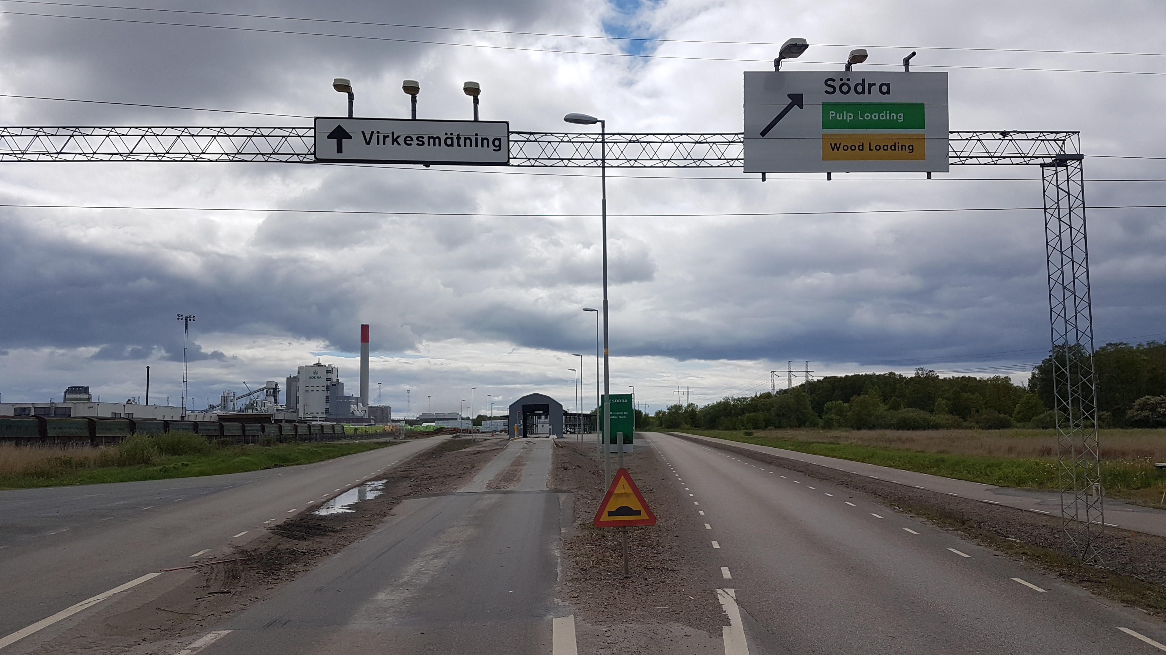
Welcome to Södra
Call before you arrive to the Measuring Station
Follow the yellow line, and park at the scale

Slide 2
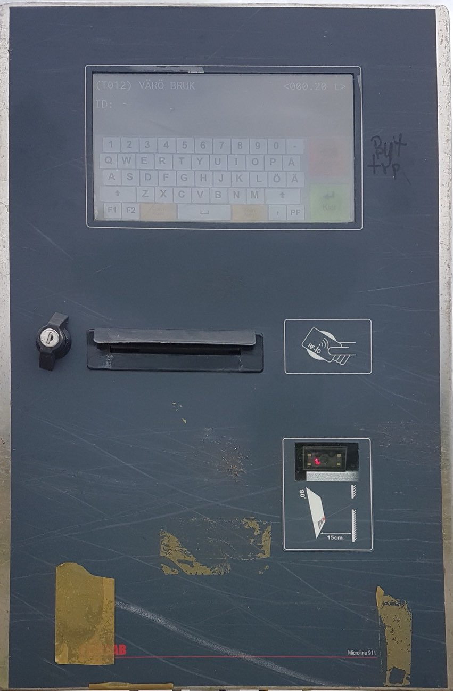
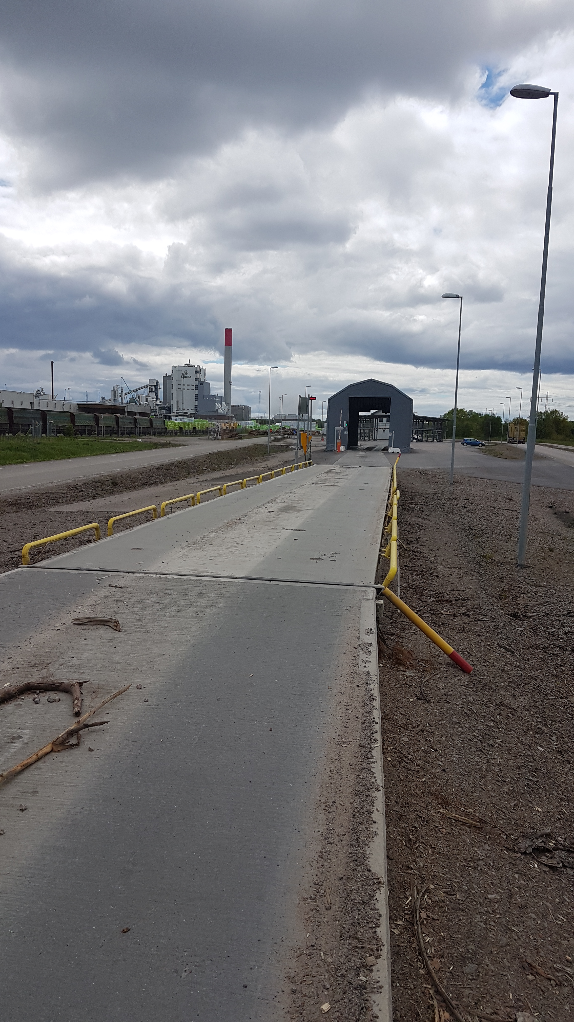
Park truck on the scale.
Call one of the number below
0340 628170
0340 628171
Describe what you will load,
        In this case Pellets
You will receive a number [Scale-card].
Enroll the number at the screen.
      The scale calculates the empty weight of the truck
Park truck on the scale

Slide 3
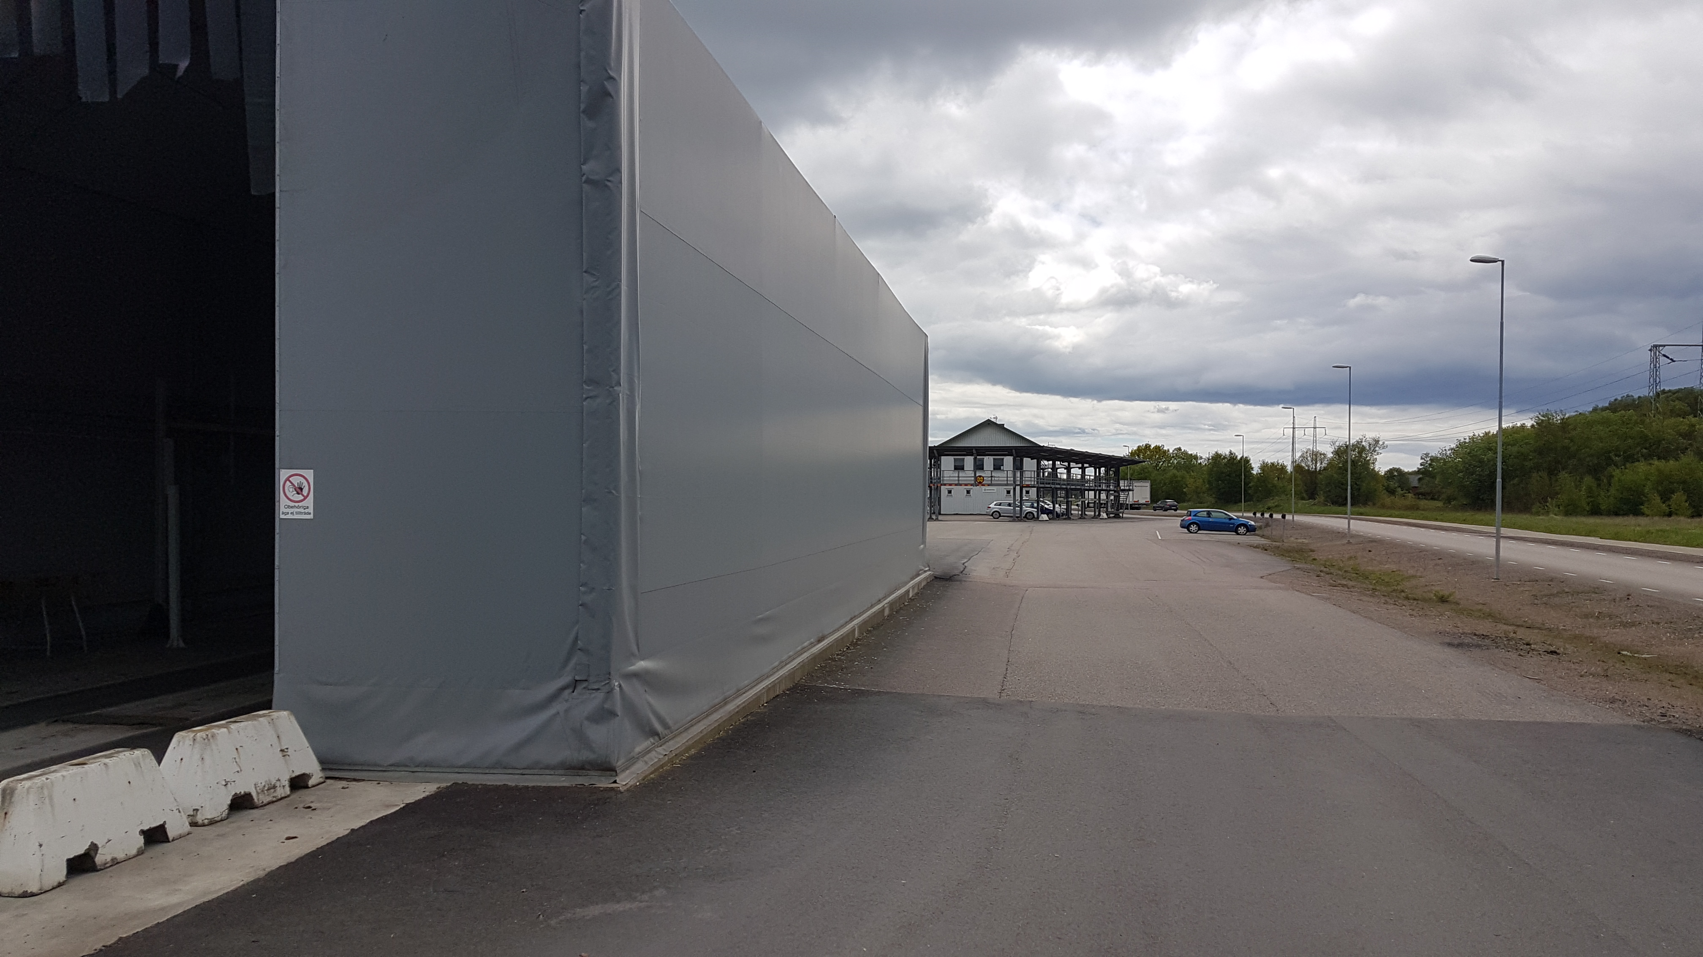
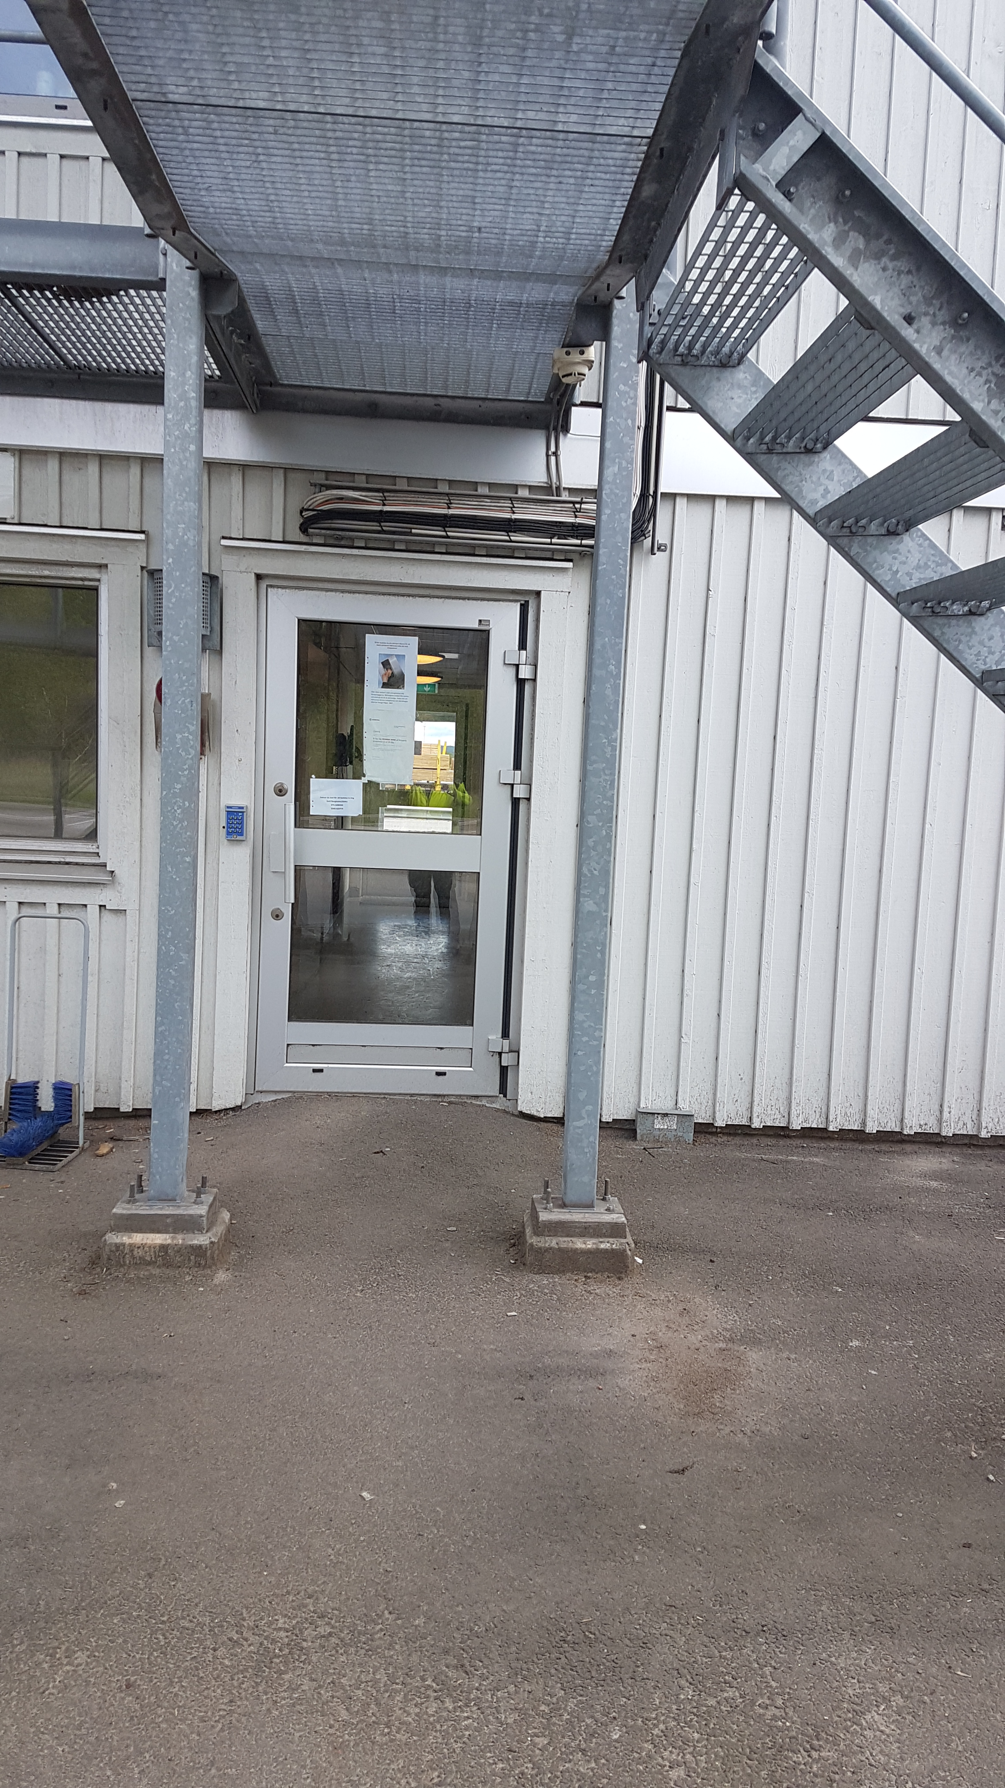
Drive beside the tent.
To have access to the gate, you must recive a SSG-card. You get the card in the reception at the Measuring Station. [Second floor].

Slide 4
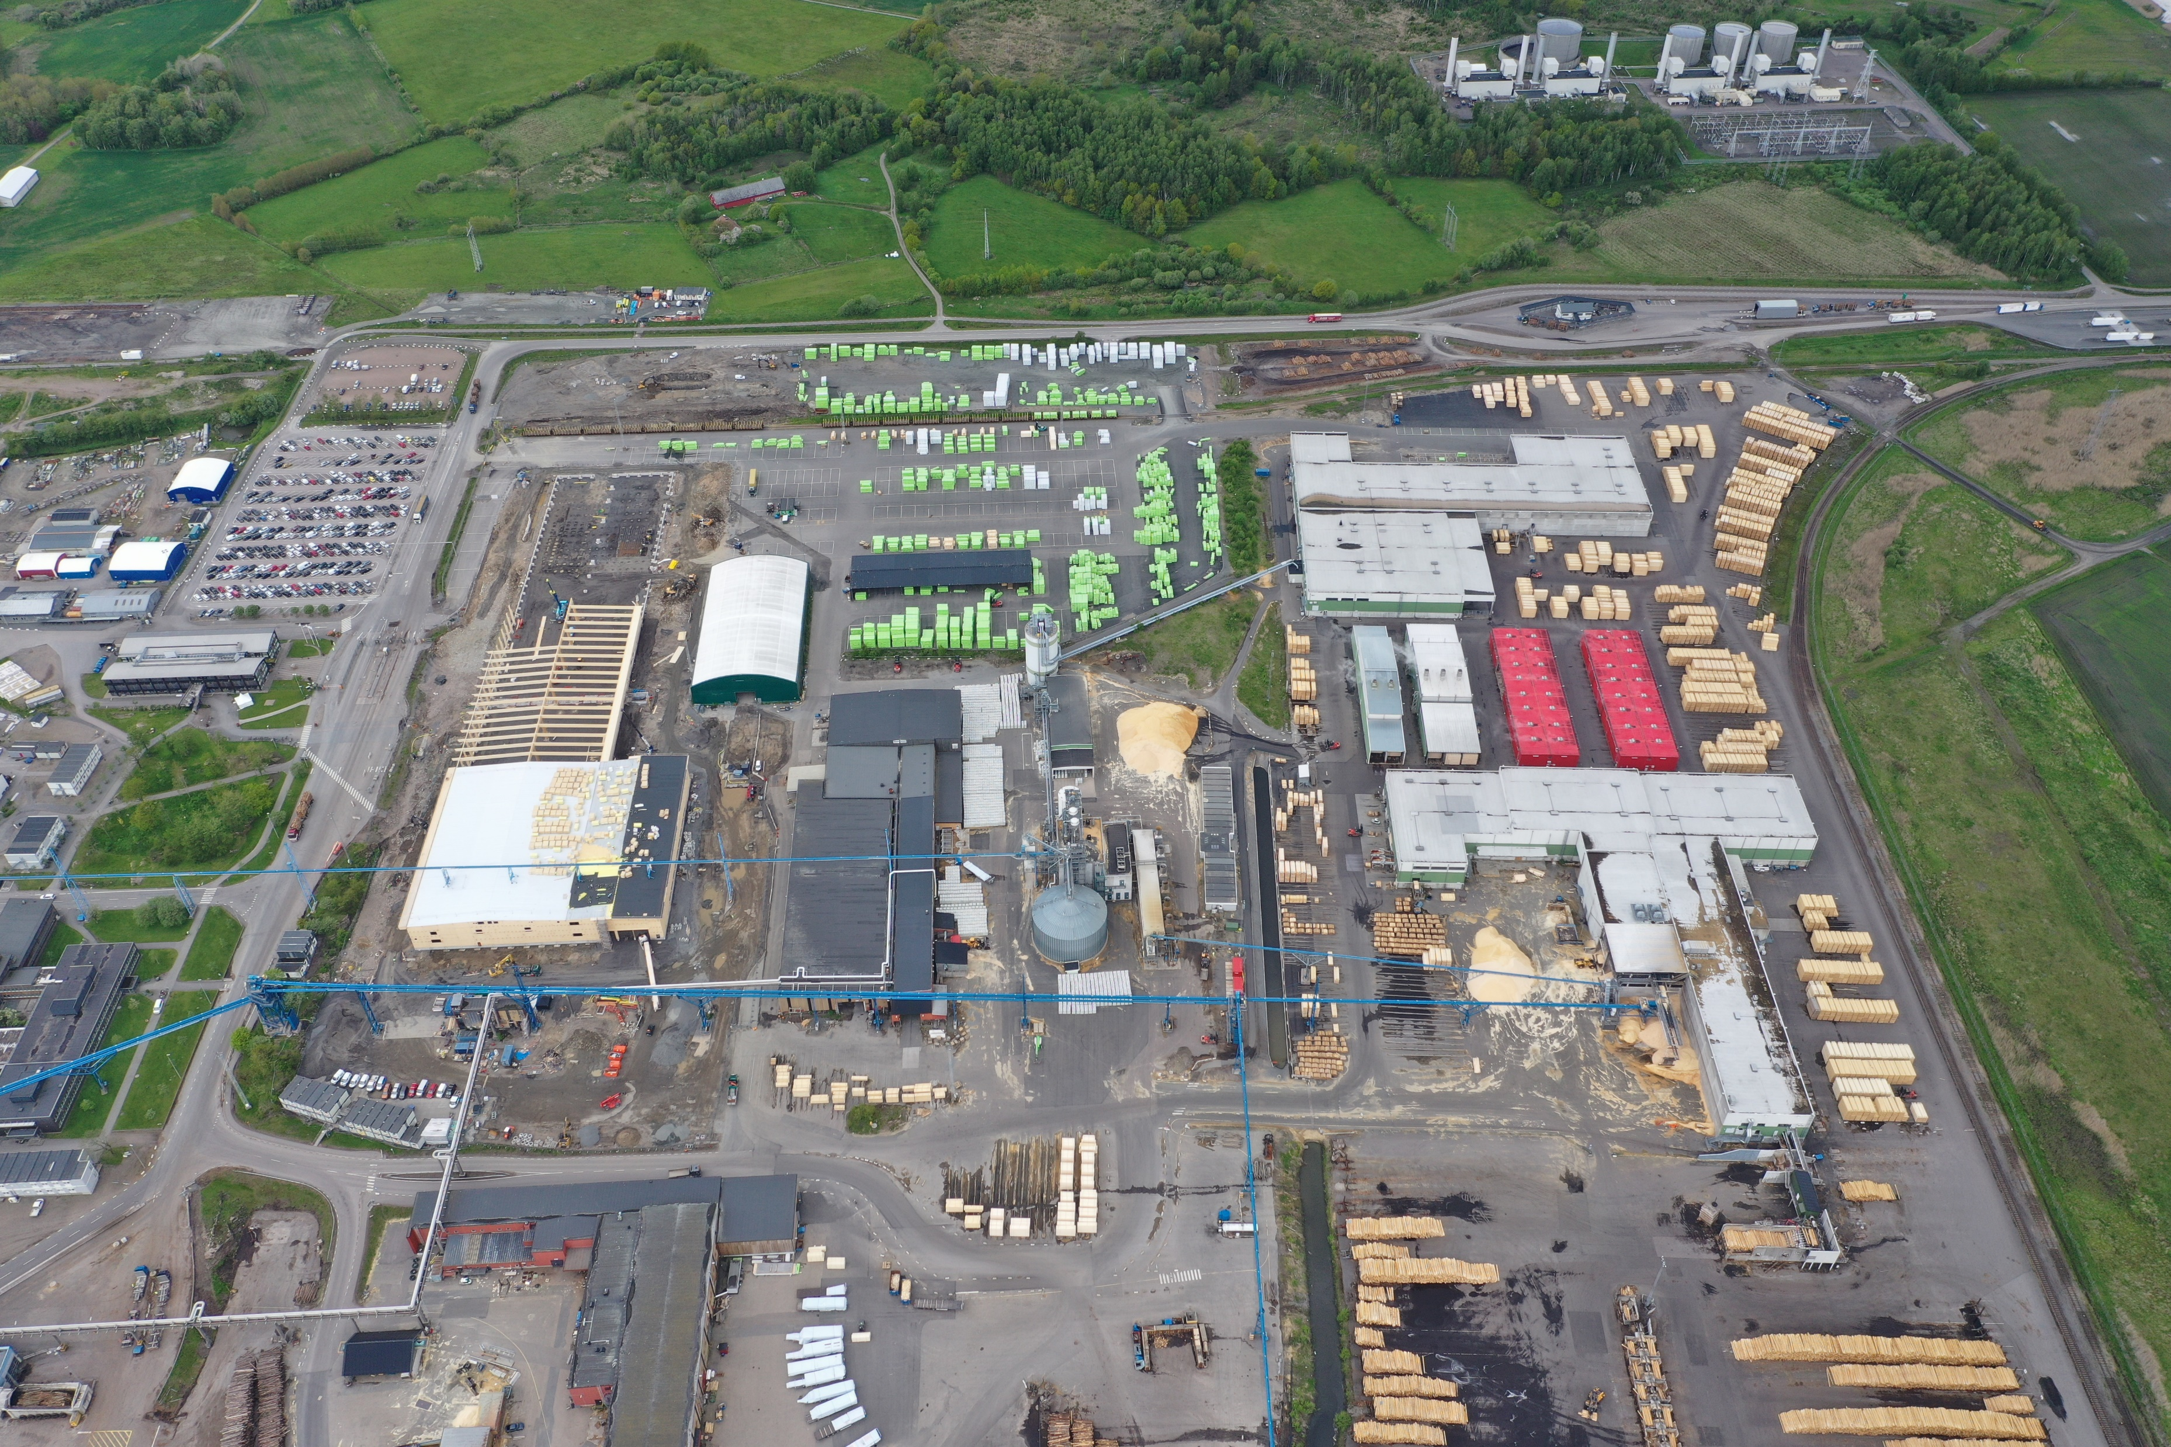
Measuring Station
Get access card
Vehicle entrance,
Use the gate to the rigth.
Measure the weight of the truck
Follow the yellow line on the map to
successfully drive to the Loading station.
The Red arrow is the Loading station.

Slide 5
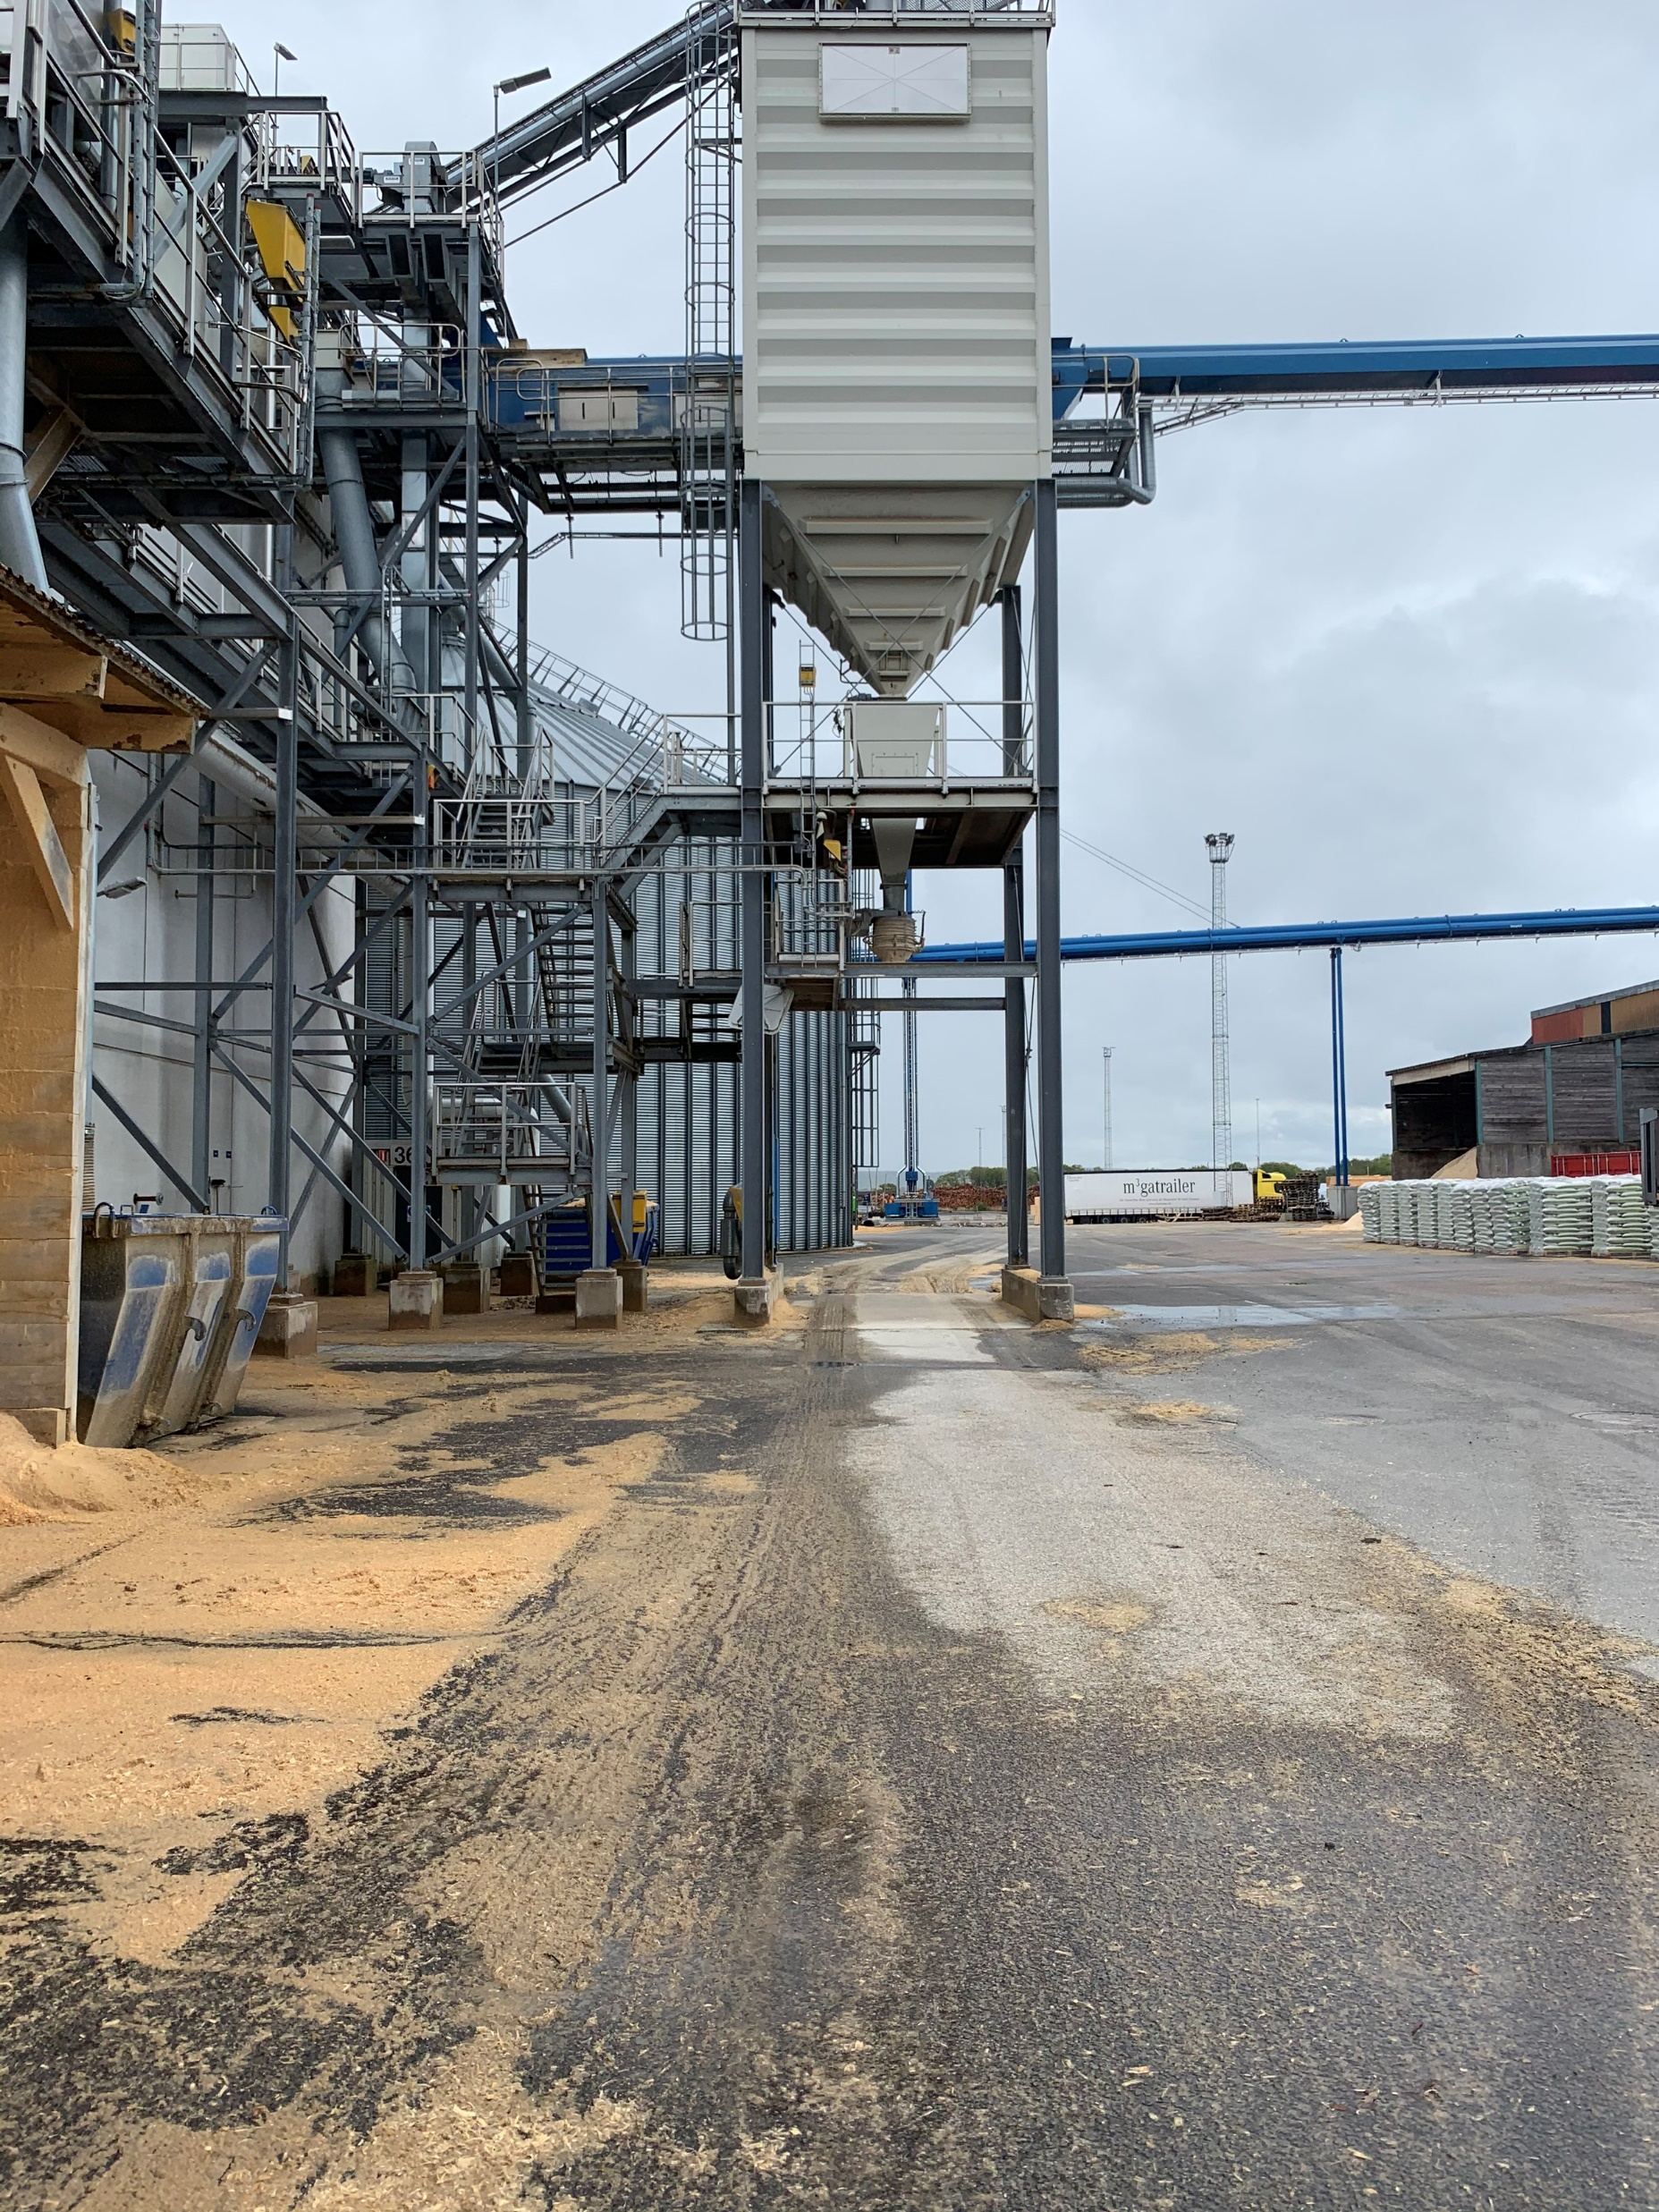
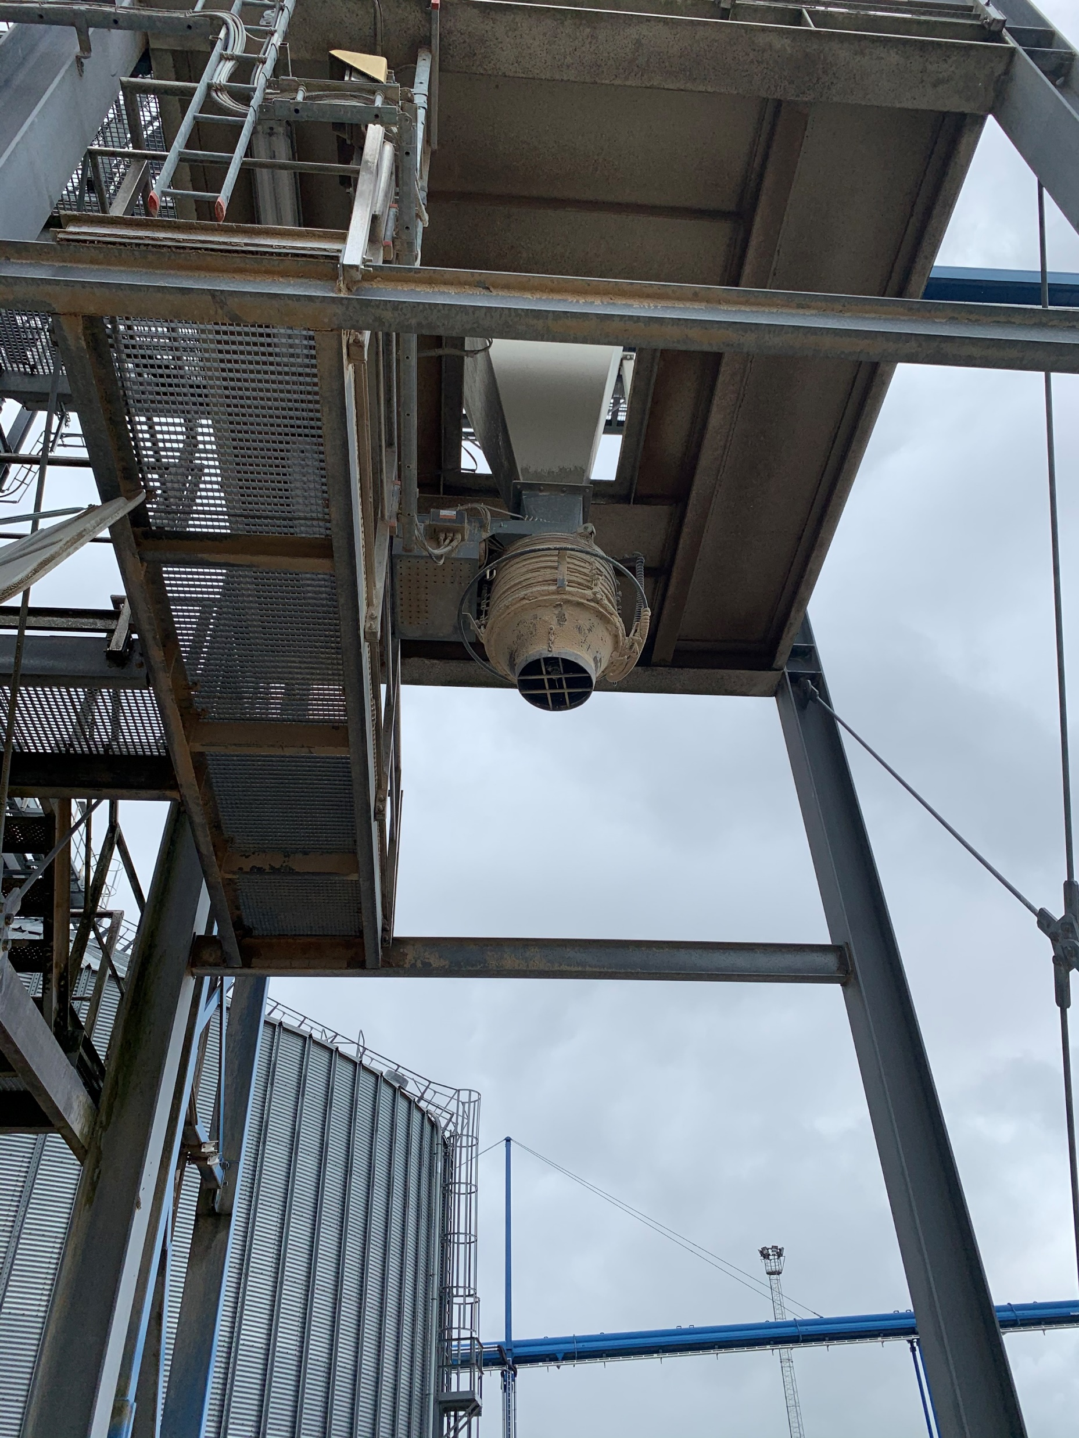
NOTE: That you perform the loading yourself
Place your vehicle/truck under the loading station.
Yellow circle is the output of pellets.

Slide 6
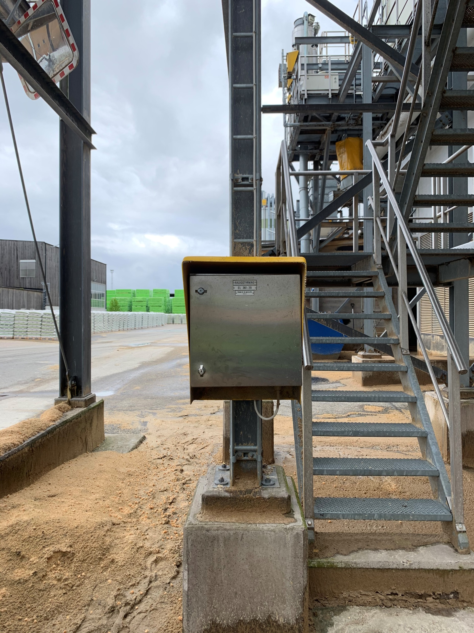
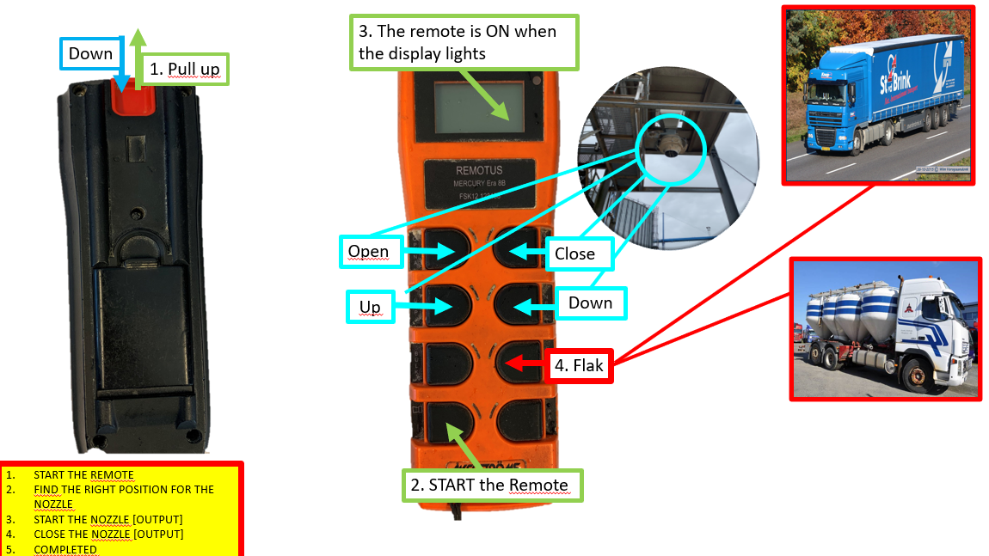
Next/beside to the loading station is a locker.
The remote is in this locker.
Follow the guide for the remote.

Slide 7
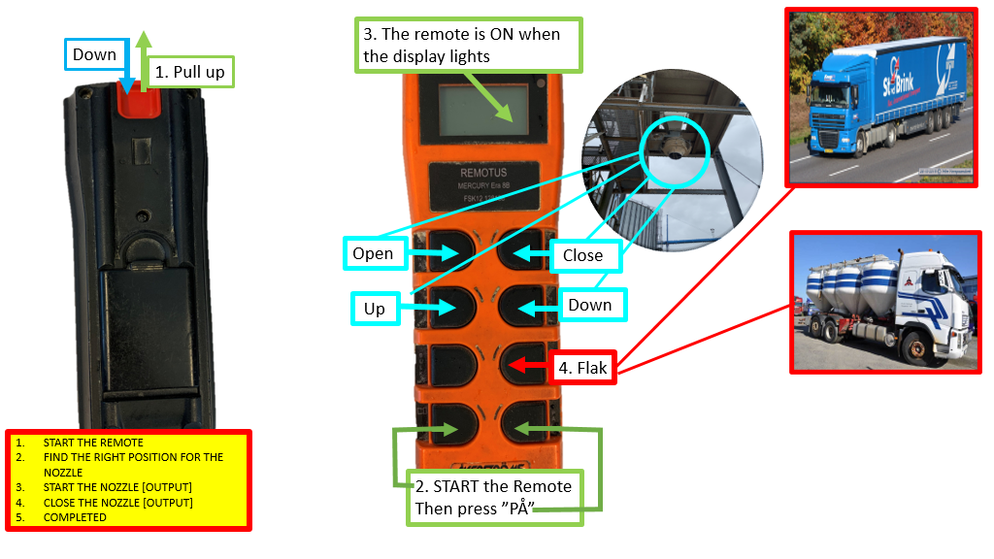

Slide 8
Park the truck.
Leave your access card
Measuring Station
Follow the green line on the map when you leave the Loading station.
When you leave the area at the exit, you need to weigh the truck. It is a small house next to the gate.
The last step is to return the card at the measuring station.

Slide 9
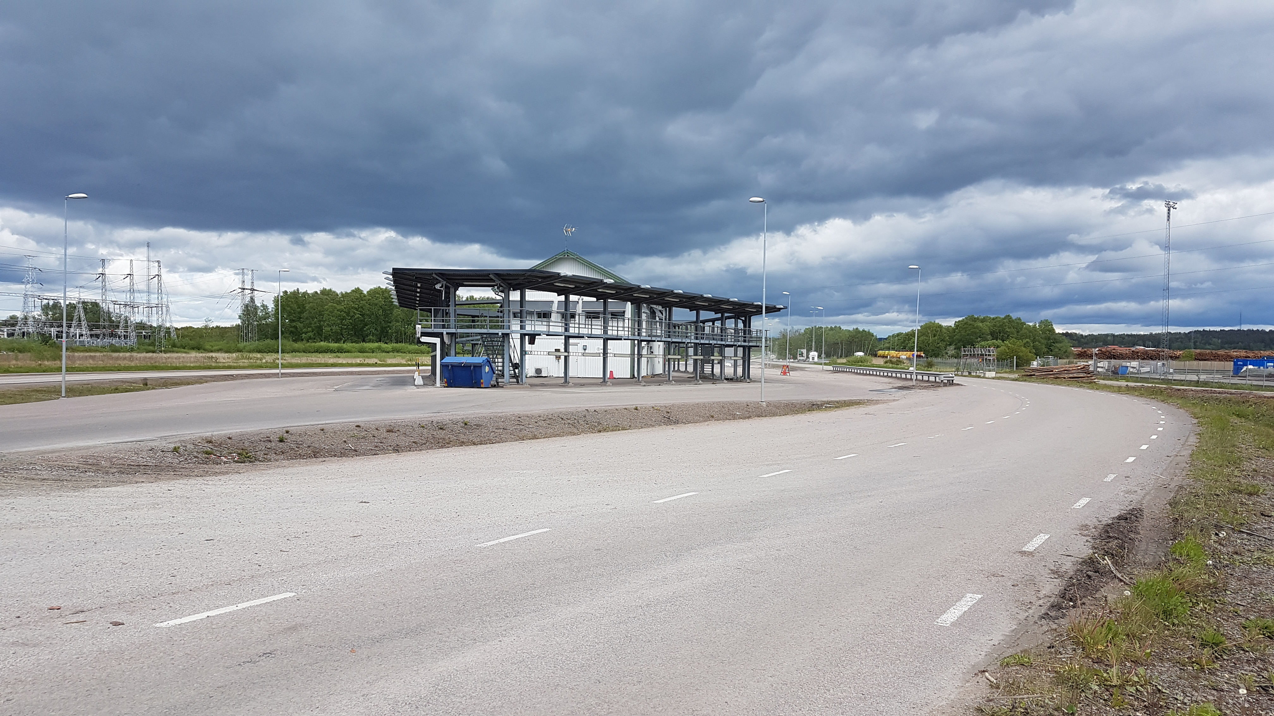
Measuring Station
The last step is to return the
card inside the measuring station.
Follow green line,
Park here

